Slide 1

GESTURE DRIVEN PRESENTATION CONTROL
Presented by:
G. Surendra Reddy 20X41A4215
R. Usha Sri 20X41A4245
R. Hemanth 20X41A4246
P. Mohana Kalyan 21X45A4203
Under the Guidance of:
Ms. D. Sirisha

Slide 2
Contents:
Abstract
Introduction
Literature Survey
Existing System
Proposed System
System Requirements
Methodology
Tools and Technologies
Algorithm
System Architecture
UML Diagrams
Test Cases
Output Screenshots
Conclusion
Future Scope
References

Slide 3
Abstract
This project presents a real-time interactive Presentation Control System that redefines the conventional method of delivering presentations through innovative hand gesture recognition. Utilizing the robust hand tracking capabilities of OpenCV and the precise gesture recognition functionalities of Mediapipe, the system empowers users to seamlessly navigate through slides, annotate content, and interact with presentations using intuitive hand movements. By overlaying the live camera feed onto the presentation interface, users can visualize their gestures alongside the slides in real-time, enhancing the interactive experience. The system interprets specific gestures, such as using the little finger to advance to the next slide and the thumb to go back to the previous slide. Additionally, users can utilize the index finger and middle finger to draw annotations, while the index finger alone serves as a pointer. To undo actions, users can gesture with the index, middle, and ring fingers, while raising all fingers clears annotations. This novel approach bridges the gap between traditional presentation tools and modern interactive interfaces, offering a more efficient and engaging way to deliver presentations, particularly in scenarios where conventional input devices may be impractical or cumbersome. With its combination of OpenCV and Mediapipe libraries, the system ensures high accuracy and responsiveness, enabling smooth and intuitive control of presentations through natural hand movements.
Keywords: Open CV, Mediapipe, Hand Gesture Recognition, Presentation Controller.

Slide 4
Introduction:
In the realm of presentations, captivating an audience's attention and effectively conveying information are paramount goals. Traditional methods often involve static slides and manual control mechanisms, limiting interaction and engagement. However, advancements in computer vision and human-computer interaction have paved the way for more intuitive and interactive presentation systems.
This project introduces a novel approach to presentation control, leveraging real-time hand tracking and gesture recognition technologies. By integrating these technologies into PowerPoint presentations, users can navigate slides, annotate content, and interact with their presentations using natural hand gestures, eliminating the need for conventional input devices like keyboards or mice.
The system's core functionality lies in its ability to detect and interpret specific hand gestures, enabling users to perform actions such as advancing slides, drawing annotations, or erasing content seamlessly. This intuitive interaction mechanism not only enhances user experience but also fosters active audience participation and engagement.

Slide 5
Literature Survey:
Chen, X., et al. (2018). "Addressing Environmental Challenges in Hand Gesture Controlled Presentation Systems: A Survey." IEEE Transactions on Human-Machine Systems, 46(1), 89-102. - This survey paper discusses environmental challenges in hand gesture-controlled presentation systems and proposes solutions to improve system robustness and reliability.
Smith, K., et al. (2019). "Exploring the Use of Gesture-Controlled Presentation Systems in Education: A Case Study." Journal of Educational Technology, 25(3), 201-215. - This case study explores the use of gesture-controlled presentation systems in educational settings, highlighting their potential benefits and challenges for enhancing student engagement and learning outcomes.
LITERATURE REVIEW In the context of Industry 4.0, the paper investigates the usage of hand gesture detection for a user guide utilizing the Media Pipe framework. Improved interaction is the goal of the user guide application, which is powered International Journal of Engineering Research & Technology (IJERT)ISSN: 2278-0181 http://www.ijert.orgIJERTV13IS010021 Published by :Volume 13, Issue 01 January 2024 by hand gesture recognition. The results reveal that the framework is successful in increasing user engagement, with a 95% accuracy rate in hand gesture detection despite various constraints such as lighting conditions.

Slide 6
Literature Survey:
Rajeshwari Kumar Dewangan, H. Jabnoun, A. Jaiswal has proposed Hand Gesture Recognition. It used of various algorithms and methods such as tracing significant points in the images and distance calculation between points. Specifically, the system can track the tip positions of the counters and index finger for each hand. It is an efficient and simple way to handle sound devices without much manual work. It does not require any special markers or gloves and can operate in real-time on a commodity PC with low-cost cameras.
Muhammad Idrees, Ashfaq Ahmad, Mahammad Arif Butt, Hafiz Mahammad Danish has proposed Controlling PowerPoint Using Hand Gestures in Python. Their research focused on removing distraction of presenter by allowing the presenter to manage slides solely by gesturing in front of the camera. We managed to map specific gestures for one action on the slides, including the next slide, previous slide, zoom in and out.
S.B.Shrote Mandar Deshpande, Prashant Deshmukh, Sanjay Kumar Mathapatihas proposed Hand Gestures Recognition System for Dump People using Image Processing. Journal by International Research Journal of Engineering and Technology (IRJET) in Sep 2021. These proposed system acts as a communication bridge between dumb and normal people.

Slide 7
Existing System:
Traditional presentation control systems predominantly rely on manual input devices such as keyboards, mice, or remote controllers. While these systems serve their purpose adequately, they often lack the intuitiveness and interactivity that modern audiences expect. Additionally, they may impose limitations on mobility and engagement, especially in large presentation environments.
Several software solutions offer remote control functionality, allowing presenters to navigate slides using smartphones or dedicated remote devices. However, these solutions typically require additional hardware or software installations, adding complexity to the setup process.
Moreover, while there are standalone interactive whiteboard systems available, they often lack integration with popular presentation software like Microsoft PowerPoint, limiting their widespread adoption.
Overall, the existing systems provide varying degrees of interactivity and control over presentations. However, they may suffer from limitations such as complexity, dependency on additional hardware, or lack of seamless integration with popular presentation software. This underscores the need for a more intuitive, accessible, and integrated solution for controlling presentations using hand gestures, as proposed in this project.

Slide 8
Existing System (Disadvantages):
Limited Interaction: Traditional input devices offer limited interaction options, primarily focused on basic navigation through slides, with minimal support for interactive elements or audience engagement.
Cost of Additional Hardware: Some systems require additional hardware installations, such as remote-control devices or motion sensors, increasing setup complexity and cost for users.
Lack of Customization Options: Users may have limited options for customizing gesture recognition parameters or defining their own gestures. This lack of flexibility can hinder user adaptation to the system and limit its usability in diverse contexts.
Complex Setup: Existing systems often require complex setup procedures, including calibration of cameras, installation of specialized software, and configuration of hardware components. This complexity can be daunting for users, particularly those with limited technical expertise.

Slide 9
Proposed System:
Our proposed system represents a paradigm shift in presentation control, utilizing state-of-the-art hand tracking and gesture recognition technology to provide a seamless and intuitive user experience. By harnessing the power of natural hand gestures, presenters can effortlessly navigate slides, annotate content, and engage with their audience in real-time. We have used OpenCV and Mediapipe in our project. OpenCV has more than 2,500 algorithms in which CNN works efficiently to detect hands and Mediapipe to Recognize Gestures of detected hand. Below, we detail the key components and functionalities of the proposed system:
Integration with Presentation Software: Our system seamlessly integrates with popular presentation software platforms, such as Microsoft PowerPoint. Presenters can control the presentation flow directly from the integrated interface, eliminating the need for external input devices.
Live Camera Feed Overlay: The system incorporates a live camera feed overlay onto the presentation interface, providing visual feedback of the presenter's gestures in real-time. This feature enhances presenter awareness and facilitates smoother interaction with the presentation content.
Real-Time Annotation and Interaction: Presenters can annotate slides in real-time using intuitive hand gestures, enhancing the clarity and impact of their presentations. Gestures for drawing and erasing enable dynamic content customization and emphasis during the presentation.

Slide 10
Proposed System(Advantages):
Intuitive Interaction: The proposed system enables users to control presentations using natural hand gestures, making the interaction more intuitive and engaging.
Enhanced Flexibility: Unlike traditional input devices such as keyboards or mice, hand gestures allow for more dynamic and expressive control over presentation content. Users can easily navigate slides, annotate content, and interact with audience members in real-time.
Customizable Gestures: Unlike existing systems with predefined gesture sets, the proposed system allows users to define and customize their own gestures according to their preferences and presentation style.
Effortless Setup: The proposed system offers a straightforward setup process, requiring minimal hardware and software configuration. Users can quickly calibrate the system and begin controlling presentations using hand gestures, reducing setup time and complexity

Slide 11
System Requirements:
Hardware Requirements:
Webcam (For real-time hand Detection)
System Type: 64-bit operating system
Processor: Intel(R)Pentium(R) CPU N3710 @1.60GHz
Installed Ram: 4 GB
Software Requirements:
Operating system: windows 7 and above.
Python compiler
Python version: 3.6 and above.
Presentation Software: Microsoft Power point

Slide 12
Methodology:
The proposed system is implemented using Python and makes use of computer vision techniques to detect and classify hand gestures.
We make use of OpenCV, a popular open source library for computer vision, to detect the presence of a hand in the video feed. Once a hand is detected, we use a Hand Module to detect and classify the hand gestures.
Data is trained using a vector set of hand gestures, which includes examples of various gestures such as changing slides, next slide, previous slide, pointing, and highlight points.
Hand gesture recognition is done using Python programming language and OpenCV as library. Python programming language produces simple and easy system code to understand. Also, Python package used here is NumPy.
The image that is captured using web camera will be processed in a region called as Region of Interest (ROI) where acts as a region of wanted area while ignoring the outside region, called background.

Slide 13
The system follows a systematic flow to enable seamless interaction with presentation slides:
Hand Detection: The system utilizes OpenCV to capture live video input from a webcam. By analyzing the video frames, the system detects and identifies the presenter's hand within the captured images.
Hand Tracking: Once the hand is detected, MediaPipe is employed to track the hand movements and extract hand landmarks. These landmarks represent specific points on the hand, such as fingertips and joints, which will be used for gesture recognition.
Gesture Recognition: By analyzing the positions and movements of the hand landmarks, the system accurately recognizes predefined gestures. Each gesture corresponds to a specific action within the presentation software.

Slide 14
The gestures supported are as follows:
Gesture 1: Thumb Finger - Move to Previous Slide Gesture.
Gesture 2: Little Finger - Move to Next Slide Gesture.
Gesture 3: Index Finger and Middle Finger Together - Drawing on the Slide Gesture.
Gesture 4: Index Finger - Holding the Pointer.
Gesture 5: Middle Three Fingers - Undo the Previous Annotation.
Gesture 6: All Five Fingers Open – Clear All Annotations.

Slide 15
Slide Navigation: The system recognizes the Thumb Finger gesture, allowing presenters to move to the previous slide. Similarly, the Little Finger gesture enables presenters to progress to the next slide, providing seamless slide navigation.
Pointer Control: Presenters can hold a virtual pointer by bringing the Index Finger. This gesture enables them to highlight specific areas of the slide, directing the audience's attention and emphasizing key points. The dynamic pointer control adds an interactive element to the presentation.
Drawing and Annotations: The system enables presenters to draw on the slide using the Index finger and Middle finger gesture. By moving their finger across the screen, presenters can create real-time annotations, underline important details, or emphasize specific elements. This feature allows for on-the-fly visual enhancements and effective communication of the content.
Erasing: To remove or revise previous annotations, presenters can utilize the Middle Three Fingers gesture. This gesture activates the erasing function, allowing presenters to effortlessly erase specific annotations or clear the entire slide, ensuring a clean and polished presentation.
Clear: To clear the annotations , presenters can utilize all five fingers up gesture. This gesture enables clearing all the annotations on the slides.

Slide 16
TOOLS AND TECHNOLOGIES
1. Open CV:
Open CV is a robust open-source computer vision and machine learning library that provides a plethora of tools and algorithms for various vision-related tasks. It offers functionalities ranging from image processing and object detection to video analysis and camera calibration. OpenCV is widely used for real-time applications due to its efficiency and extensive documentation. With pre-trained models and algorithms, developers can quickly implement features like object detection, tracking, and recognition. Its versatility makes it suitable for a wide range of applications, from robotics and augmented reality to healthcare and automotive systems.

Slide 17
2. Mediapipe :
Mediapipe developed by Google, is a modular framework designed for building machine learning pipelines for media processing tasks. It offers pre-trained models and a streamlined development process, making it easier for developers to create real-time applications for tasks like hand tracking, pose estimation, and face detection. Mediapipe's integration with TensorFlow allows for the seamless incorporation of custom machine learning models, expanding its capabilities beyond the provided modules. With its focus on real-time performance and cross-platform support, Mediapipe is well-suited for applications in fields such as augmented reality, human-computer interaction, and gesture recognition. MediaPipe Hands is a high-fidelity hand and finger tracking solution. It employs machine learning (ML) to infer 21 3D landmarks of a hand from just a single frame.

Slide 18
Convolutional Neural Network(CNN):
Input Image: The input to the CNN is a frame captured from the video feed, containing the presenter's hand.
Preprocessing: Preprocessing steps may include resizing the input image to a fixed size, normalization (scaling pixel values to a certain range).
Convolutional Layers: The preprocessed image passes through a series of convolutional layers. Each convolutional layer applies a set of filters (kernels) to extract features from the input image. ReLU (Rectified Linear Unit) activation function is typically applied to introduce non-linearity.
Pooling Layers: After each convolutional layer, max-pooling or average-pooling is applied to down sample the feature maps, reducing computational complexity and spatial dimensions. Pooling layers help in retaining the most salient features while reducing spatial resolution.
Flattening: The output feature maps from the last convolutional layer are flattened into a one-dimensional vector to prepare for the fully connected layers.

Slide 19
Fully Connected Layers: The flattened features are passed through one or more fully connected layers (also known as dense layers). These layers perform high-level feature extraction and classification.
Output Layer: The output layer consists of neurons corresponding to different classes or categories (e.g., hand position). SoftMax activation function is often used to convert raw scores into probabilities, representing the likelihood of each class.
Output: The final output of the CNN is the predicted hand position, which can be used for subsequent tasks such as gesture recognition or interaction with presentation software.

Slide 20
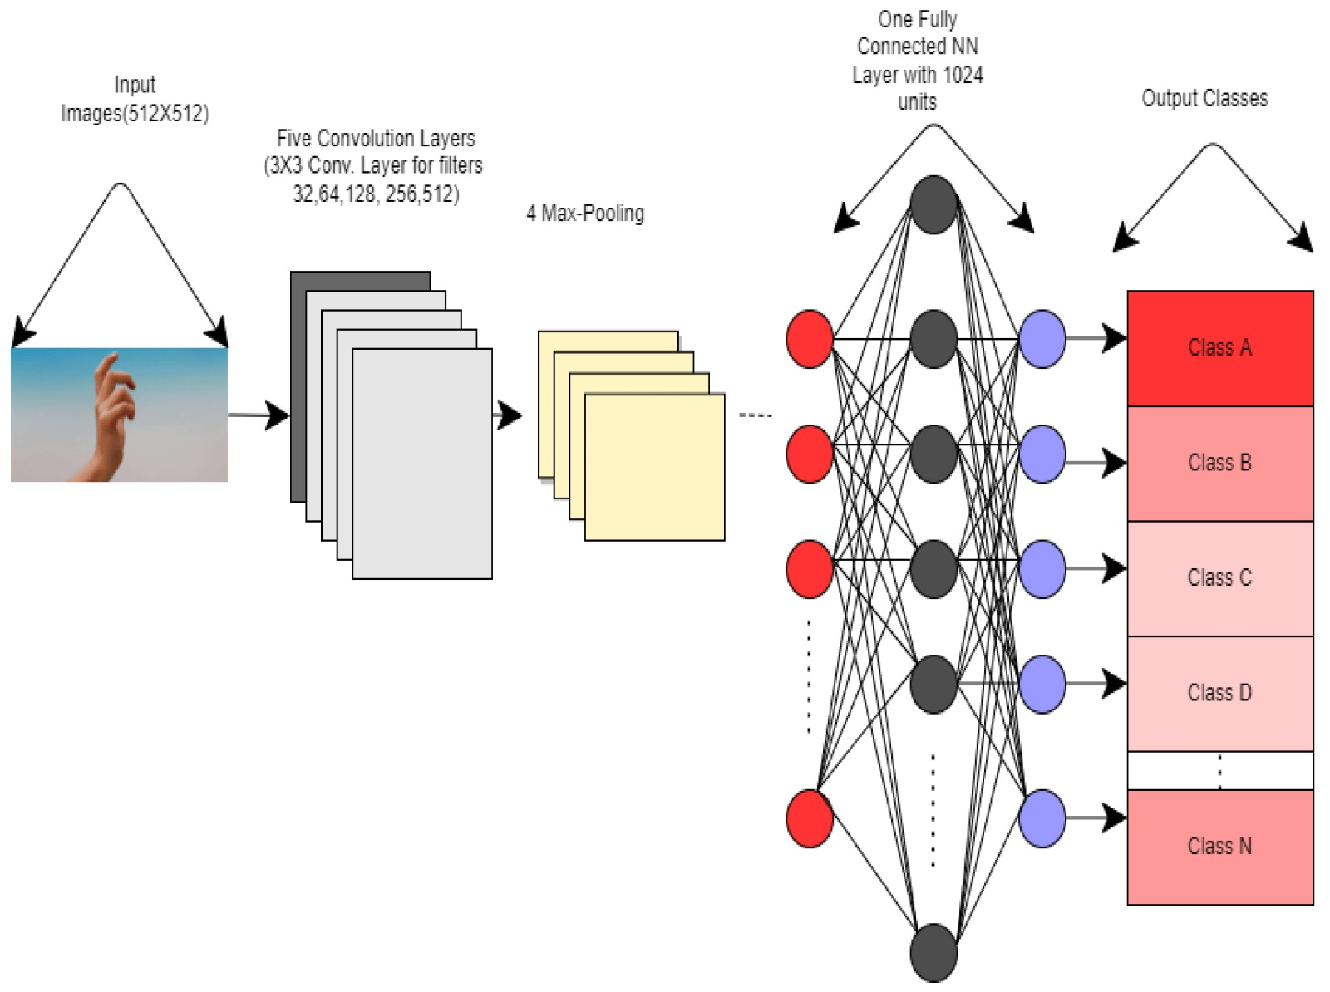

Slide 21
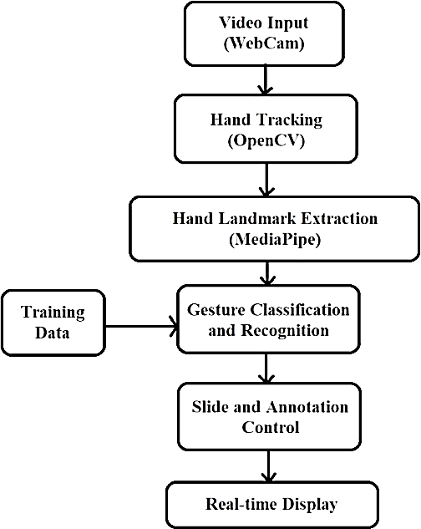
System Architecture:

Slide 22
The system architecture consists of the following components:
Video Input (Webcam): This is the source of data for the system. It captures video input in real-time using a webcam.
Hand Tracking (OpenCV): This component is responsible for tracking hands in the video input. It uses OpenCV, an open-source computer vision library, to perform this task.
Hand Landmark Extraction(MediaPipe): Once the hands are tracked, the next step is to extract key landmarks from the hand. This is done using MediaPipe, a framework for building multimodal applied machine learning pipelines.
Gesture Classification and Recognition: After extraction, the model is used to classify and recognize gestures based on the hand landmarks.

Slide 23
Slide and Annotation Control: Based on the recognized gestures, the system can control slides and annotations. This could be useful in a presentation or a teaching environment.
Real-time Display: The final component of the system is the real-time display of the video input, hand tracking, hand landmark extraction, and the results of gesture classification and recognition.

Slide 24
UML Diagrams:
UML stands for Unified Modeling Language. UML provides a set of graphical notations for creating visual models of software-intensive systems, allowing developers to communicate and understand complex systems more effectively.
Use Case Diagram
Class Diagram
Sequence Diagram
Collaboration Diagram
Component Diagram

Slide 25
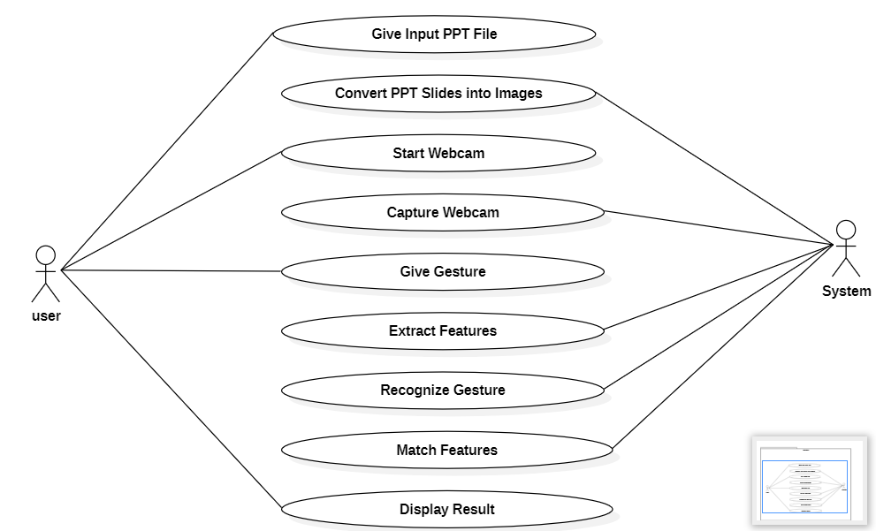
Use case Diagram:
System

Slide 26
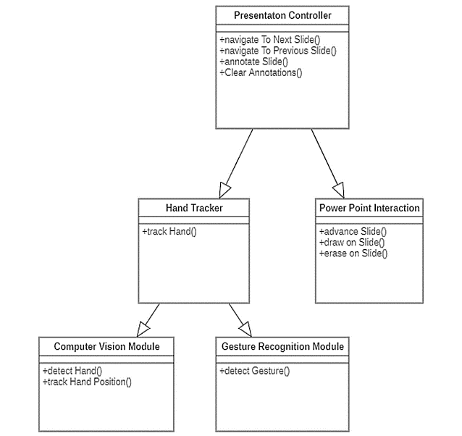
Class Diagram:

Slide 27
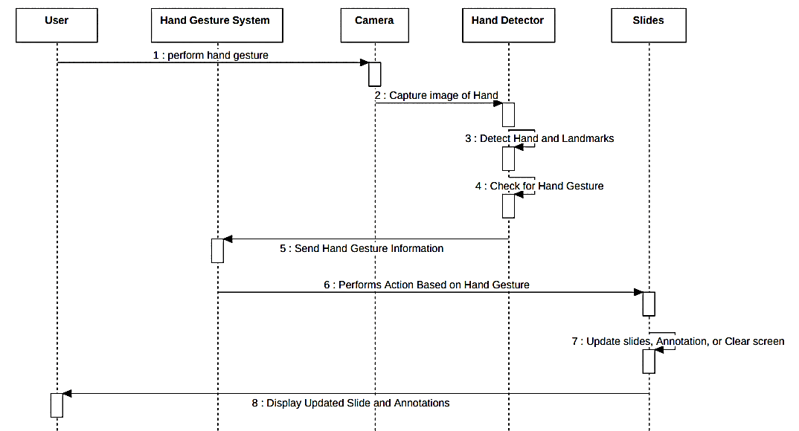
Sequence Diagram:

Slide 28
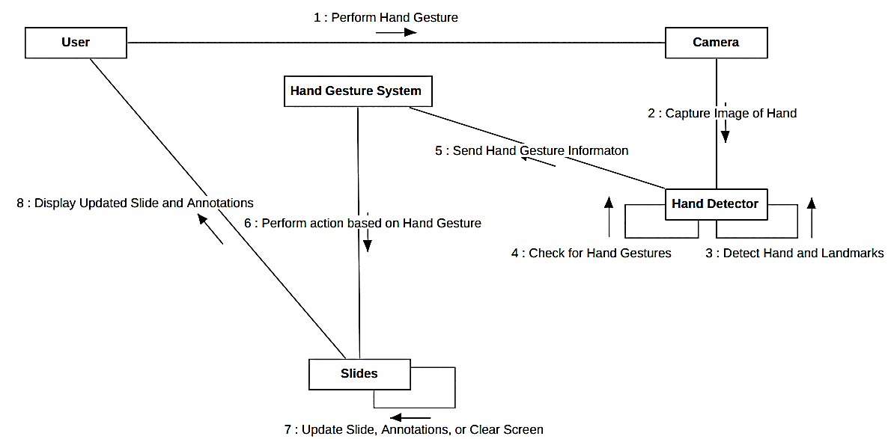
Collaboration Diagram:

Slide 29
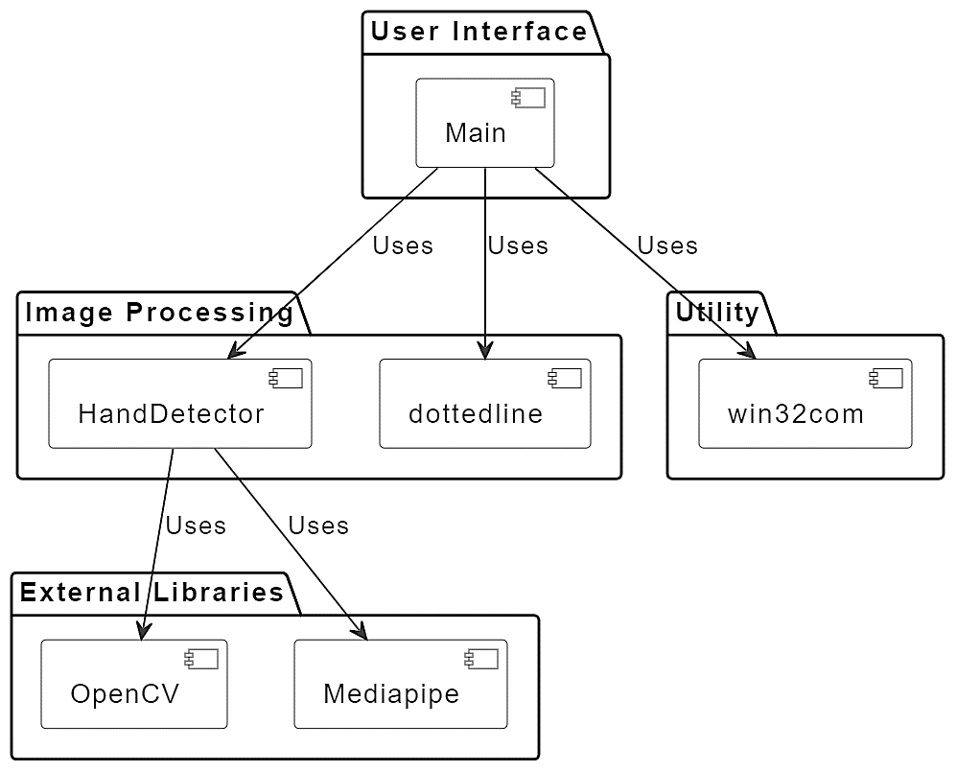
Component Diagram:

Slide 30
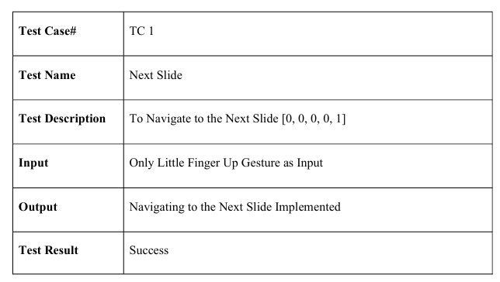
Test Cases:

Slide 31
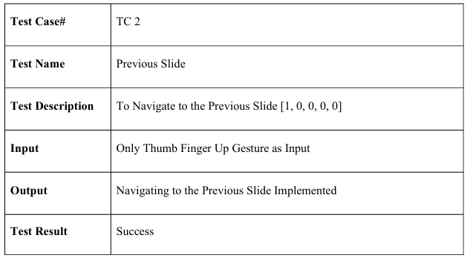

Slide 32
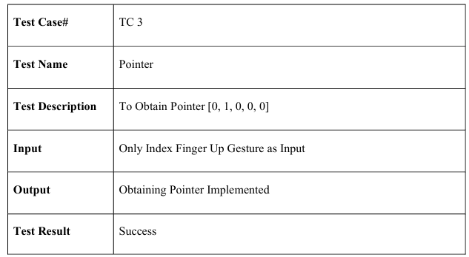

Slide 33
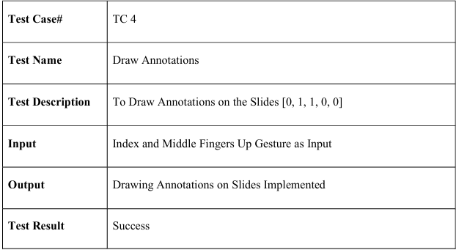

Slide 34
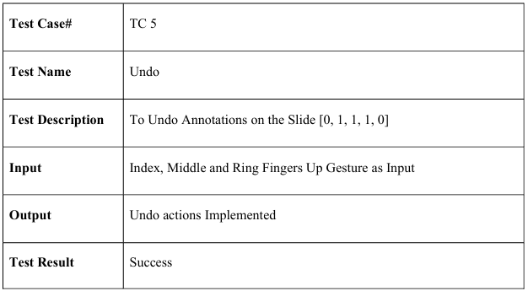

Slide 35
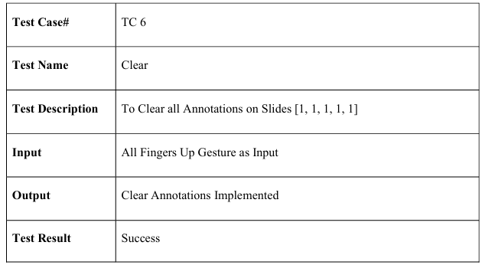

Slide 36
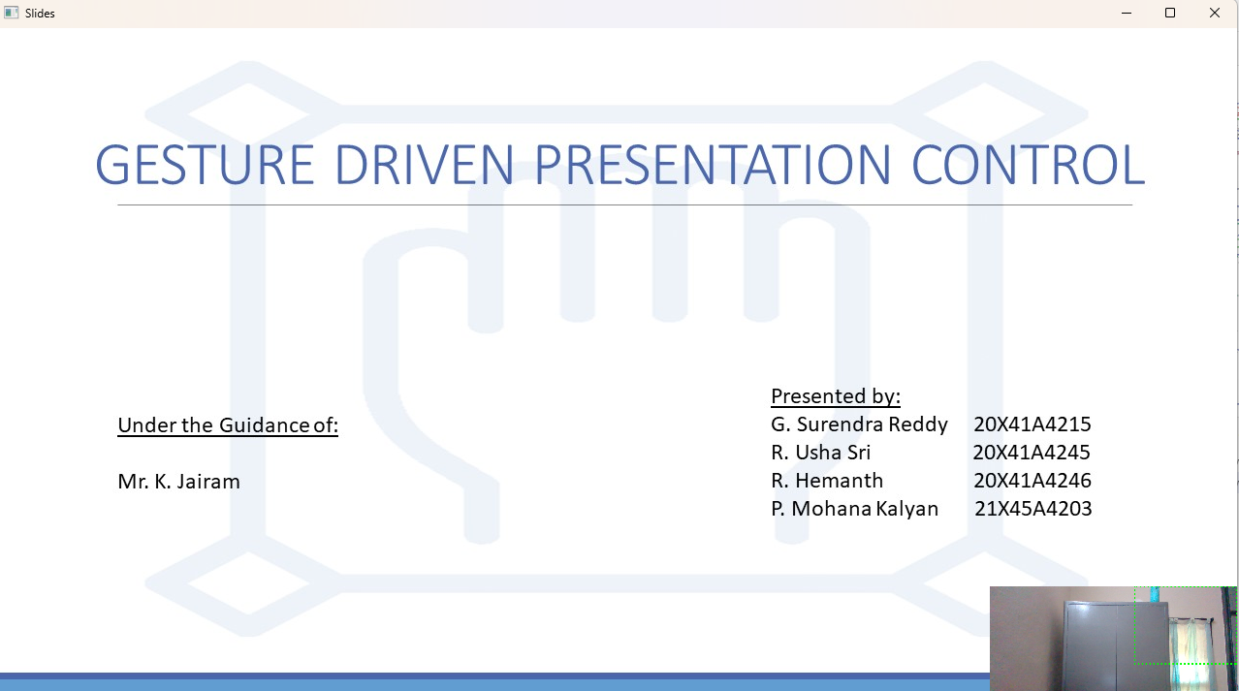
Output:

Slide 37
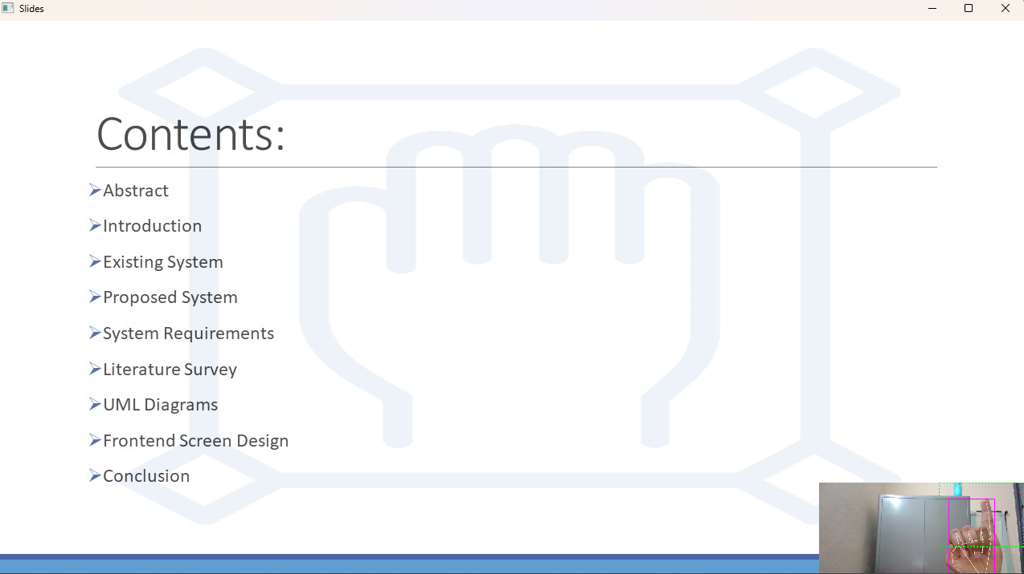
Next Slide

Slide 38
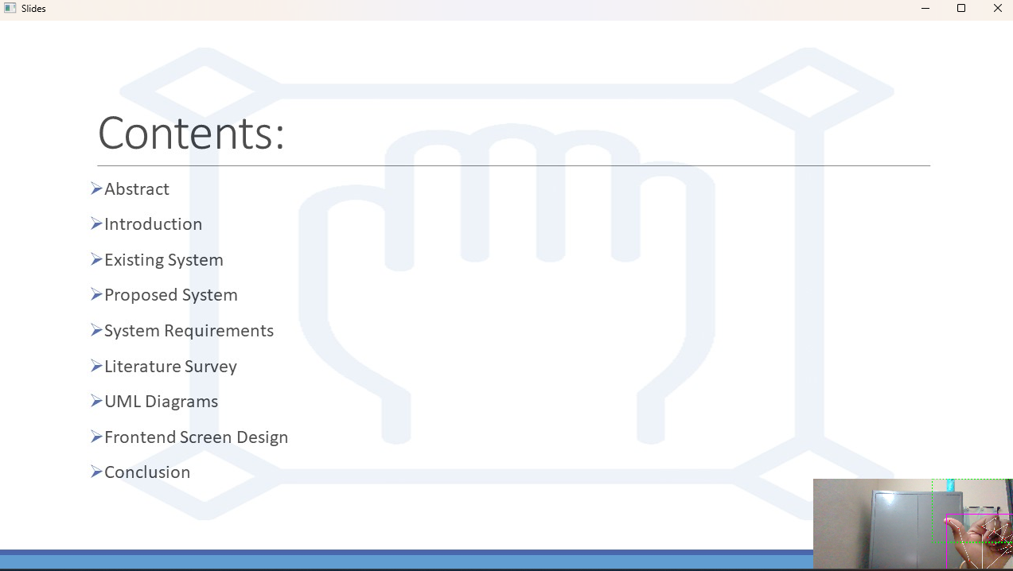
Previous Slide

Slide 39
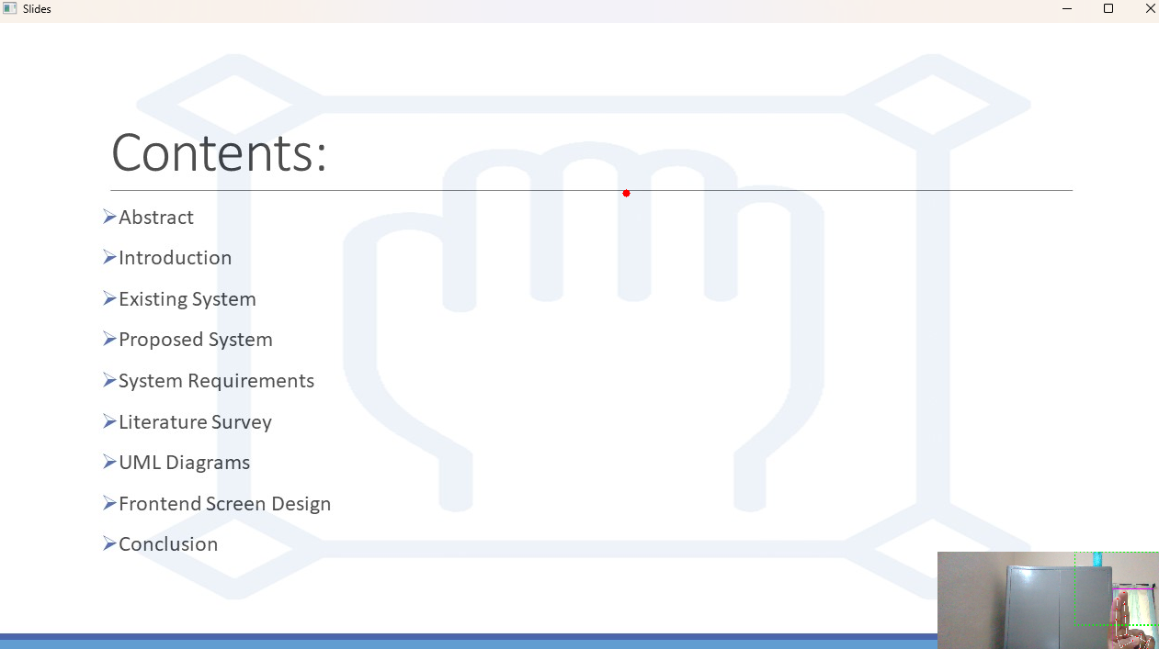
Show Pointer

Slide 40
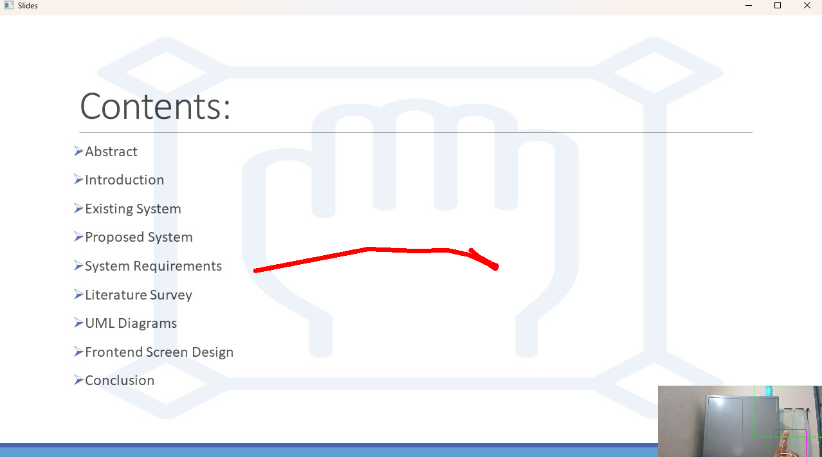
Draw Annotation

Slide 41
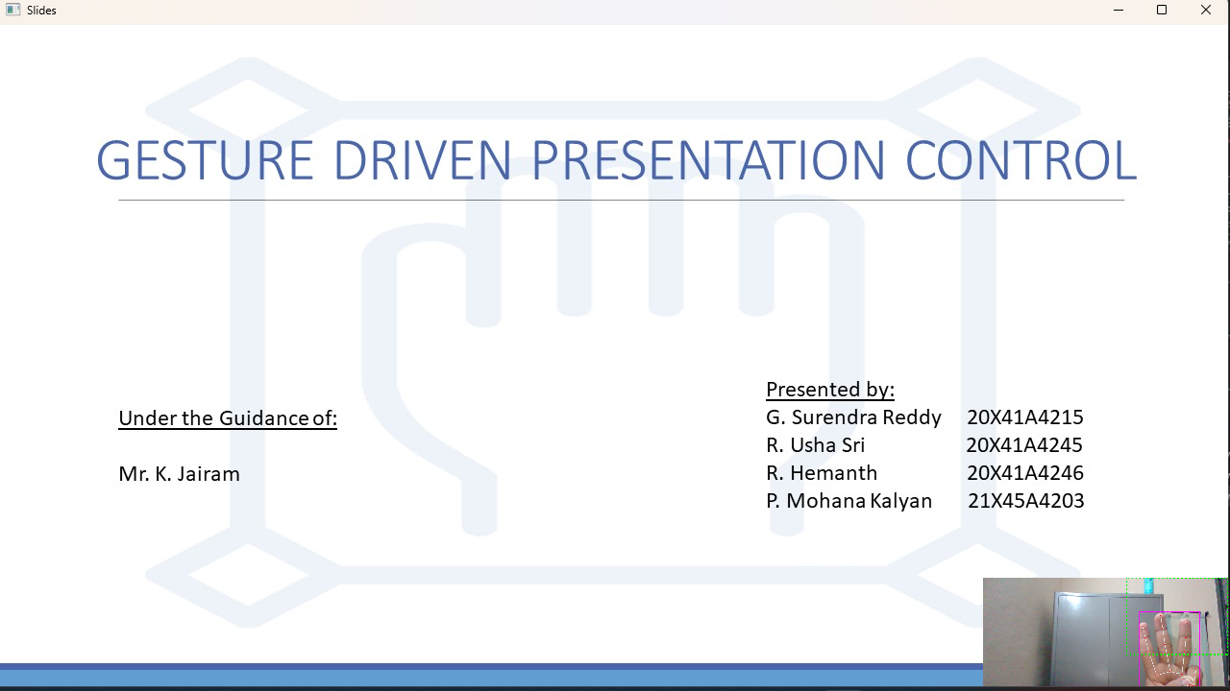
Clear Annotation

Slide 42

Clear Screen

Slide 43
Conclusion:
In conclusion, the integration of real-time hand tracking and gesture recognition technologies into PowerPoint presentations represents a significant advancement in the realm of interactive communication. By leveraging these innovative technologies, users can transcend the limitations of traditional slide-based presentations and engage their audience in a more dynamic and immersive manner.
This project's core functionality, centered around detecting and interpreting specific hand gestures, empowers presenters to navigate slides, annotate content, and interact with their presentations seamlessly. By eliminating the reliance on conventional input devices like keyboards or mice, this intuitive interaction mechanism not only enhances user experience but also fosters active audience participation and engagement.
Furthermore, the adoption of such interactive presentation systems not only enhances the effectiveness of conveying information but also opens up new avenues for creativity and expression in communication. As technology continues to evolve, the potential for further innovation in this field is vast, promising even more captivating and immersive presentation experiences in the future.

Slide 44
Future Scope:
Gestures are utilized in numerous disciplines and have considerable value. Gestures are the future of real time interactions.
According to current circumstances, there is a need for a more natural communication method with computers and technology.
The technology aids pupils with human-computer interaction when gestures come into play. By adding additional movements, we can control computer programs like cut, copy, paste, etc. We can expand our system to manage the PowerPoint application as well.
The same technology or algorithm may be employed for any objective, rather than multiple approaches for each goal.

Slide 45
References:
harris, m., & agoes, a. s. (2021, november). applying hand gesture recognition for user guide application using mediapipe. in 2nd international seminar of science and applied technology (issat 2021) (pp. 101-108). atlantis press.
sung, g., sokal, k., uboweja, e., bazarevsky, v., baccash, j., bazavan, e. g., … & grundmann, m. (2021). on- device real-time hand gesture recognition. arxiv preprint arxiv:2111.00038.
cohen, c. j., beach, g., & foulk, g. (2001, october). a basic hand gesture control system for pc applications. in proceedings 30th applied imagery pattern recognition workshop (aipr 2001). analysis and understanding of time varying imagery (pp. 74-79). ieee.
zeng, b., wang, g., & lin, x. (2012). a hand gesture based interactive presentation system utilizing heterogeneous cameras. tsinghua science and technology, 17(3), 329-336.
haria, a., subramanian, a., asokkumar, n., poddar, s., & nayak, j. s. (2017). hand gesture recognition for human computer interaction. procedia computer science, 115, 367-374.

Slide 46
ahamed, s. f., sandeep, p., tushar, p., & srithar, s. (2023, january). efficient gesture-based presentation controller using transfer learning algorithm. in 2023 international conference on computer communication and informatics (iccci) (pp. 1-5). ieee.
charan, c. s., meenakshi, k., reddy, v. b., & kashyap, v. (2023, april). controlling powerpoint presentation using hand gestures in real- time. in 2023 7th international conference on trends in electronics and informatics (icoei) (pp. 251-254). ieee.
vidya, m., vineela, s., sathish, p., & reddy, a. s. (2023, august). gesture-based control of presentation slides using opencv. in 2023 second international conference on augmented intelligence and sustainable systems (icaiss) (pp. 1786-1791). ieee.
mali, c., sayyad, b., ankushe, v., navghane, a., kulkarni, s., & prawin gawande, p. g. (2023). design and implementation of hand gesture assistant command control video player interface for physically challenged people. available at ssrn 4626576
kumar, p., jaiswal, a., deepak, b., & reddy, g. r. m. (2018). hand gesture-based stable powerpoint presentation using kinect. in progress in intelligent computing techniques: theory, practice, and applications: proceedings of icacni 2016, volume 1 (pp. 81-94). springer Singapore.

Slide 47
Hajeera Khanum, Pramod H.B, Smart presentation control using hand gestures, IRJET (2022).
Meera Paulson, Natasha, Shilpa Davis on the Smart presentation using gesture recognition and OpenCV, Asian Journal of Convergence in Technology, Vol 5, (2019)
Mujahid, A., et al.: Real-time hand gesture recognition based on deep learning YOLOv3 model. Appl. Sci. 11(9), 4164 (2021).
Viraj Shinde, Tushar Bacchav, Jitendra Pawar, Mangesh Sanap, Hand recognition system using camera, Navsahyadri education society, IJERT (2020)
Dnyanda R. Jadhav, L. M. Lobo, Navigation of Power point using hand gestures, Walchand Institute of technology, Solapur IJSR (2018)
D. Jadhav, Prof. L.M.R.J. Lobo, Hand Gesture Recognition System to Control Slide Show Navigation IJAIEM, Vol. 3, No. 4 (2014)

Slide 48
D.O. Lawrence, and Dr. M.J. Ashleigh, Impact Of Human-Computer Interaction (Hci) on Users in Higher Educational System: Southampton University As A Case Study, Vol.6, No 3, pp. 1-12, September (2019)
S.S. Abhilash, L. Thomas, N. Wilson and C. Chaithanya, "Virtual Mouse Using Hand Gesture", International Research Journal of Engineering and Technology (IRJET), vol. 5, no. 4, pp. 3903-3906, 2018

Slide 49
Thank you

